Slide 1


TEAM 51
-
AC WORK
FROST-HUB

Slide 2
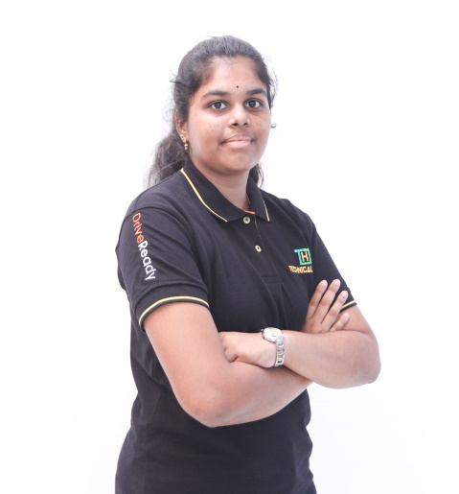
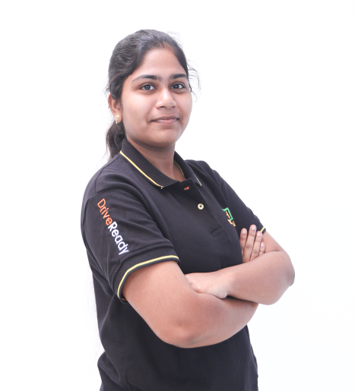
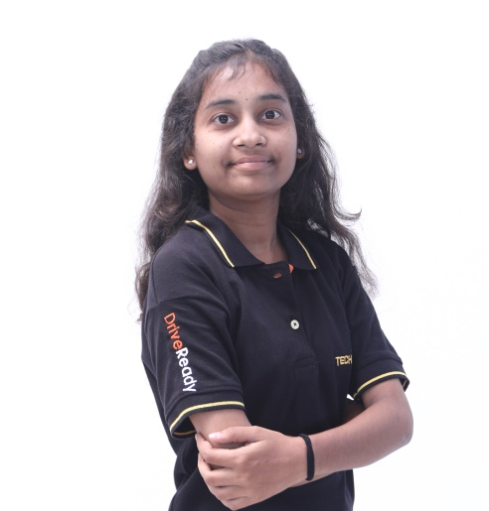
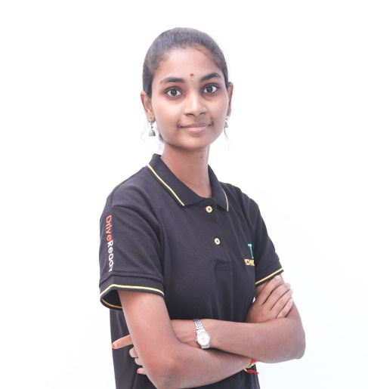
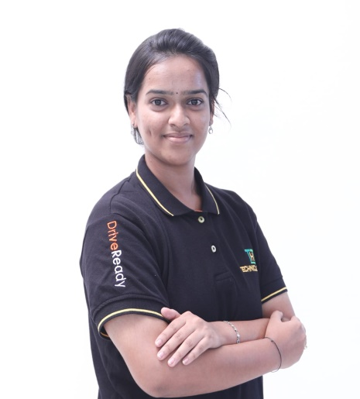
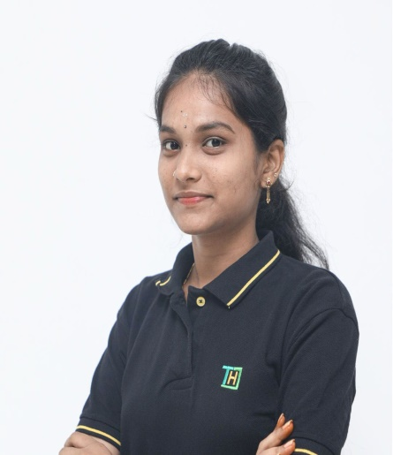
Our Team
SRI DIVYA PRABHA
PRASANNA
SUREKHA
THEJASHWINI
MEGHANA PRIYA
Cloud Engineer(Azure)
MAHESWARI
Cloud Engineer(AWS)
Full Stack Developer
Full stack developer
Full stack developer
Full stack developer

Slide 3
Agenda Of The Website
In general, whenever any issue related to AC, Refrigerator or Water Coolers is raised we need to call to the technicians and need to wait for their response. If the issue is huge, we have to wait for a long by halting all our works. This leads to the overall damage of the device.
To overcome all such issues, our website is used for the better communication between the users and the technicians which makes the process easier. Through our website the repair works will be done so fast. The user also gets the next servicing date maybe in the period of 3-6 months which will be notified to them as well as the technician/admin.

Slide 4
An Overview Of The Problem
From malfunctioning AC units to leaky refrigerators and faulty water coolers, we fix cooling and appliance woes swiftly and efficiently.
Our repair services address a range of common issues plaguing ACs, refrigerators, and water coolers, including inadequate cooling, leaks, electrical malfunctions, and noisy operation. Whether it's a malfunctioning compressor in your AC, a leaking refrigerator, or a water cooler with cooling problems, our team of skilled technicians is equipped to diagnose and resolve the problem promptly. With our expertise, we aim to restore your appliances to optimal performance, ensuring your comfort and convenience. Trust us to deliver reliable repair solutions tailored to your specific needs, keeping your home or business running smoothly.
45%

Slide 5
FULL STACK DEVELOPMENT:
React js
Node js
Mongo DB
Azure DevOps (Cloud)
AWS DevOps (Cloud)
Deployment using the Ubuntu AZURE Virtual Machine
and the Git Hub repository of the dynamic website
AI Chatbot integration using AWS Lex Tool
Technologies Used

Slide 6
Working of the project
Whenever a repair arises, the user can visit our website and can generate a token to the specific management. Then the admin will be getting a new request with the details of the user i.e, his name, college name and the description. If the admin accepts the request the details goes to the maintenance info and a notification in the form of e-mail will be sent to the user. The maintenance info is used to update the status of service. If the form is submitted, the details goes to the inventory. The inventory is for storage of services done till date. Then the services will be provided to the user.

Slide 7
THANK YOU

